Slide 1
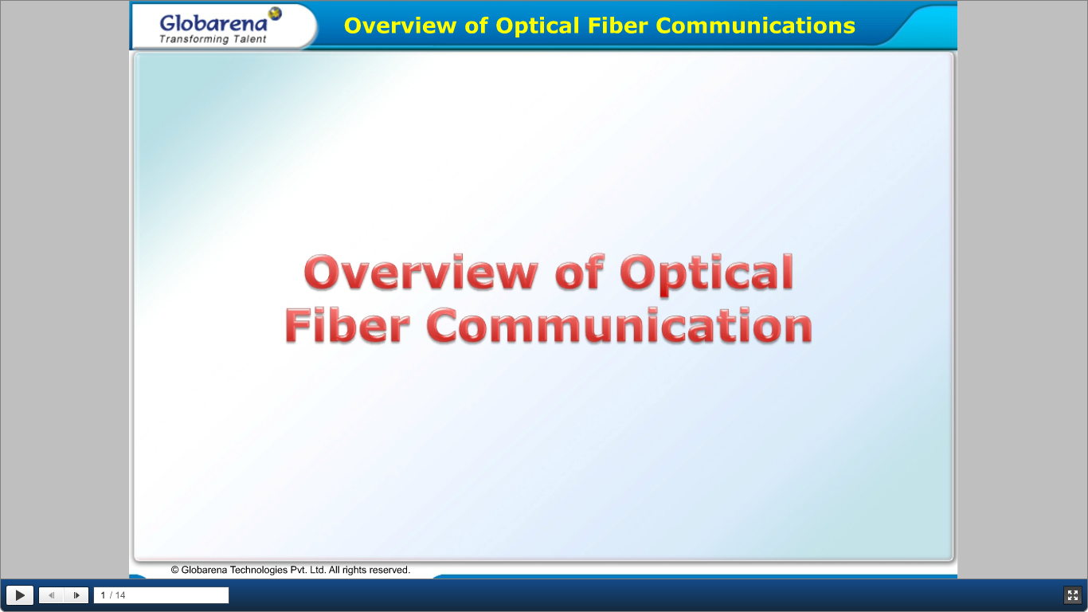

Slide 2
UNIT-I : Overview of optical fiber communication
Historical development,
The General system,
Advantages of Optical fiber communications.
Optical fiber wave guides- Introduction,
Ray theory transmission-
Total Internal Reflection
Acceptance angle
Numerical Aperture
Skew rays
Cylindrical fibers-
Modes
V-number
Mode coupling
Step Index fibers
Graded Index fibers.
Single mode fibers-
- Cut off wavelength
- Mode Field Diameter
- Effective Refractive Index, Related problems.

Slide 3
UNIT-I: Introduction
Communication may be broadly defined as the transfer of information from one point to another. When the information is to be conveyed over any distance a communication system is usually required.
Within a communication system the information transfer is frequently achieved by superimposing or modulating the information onto an electromagnetic wave which acts as a carrier for the information signal.
This modulated carrier is then transmitted to the required destination where it is received and the original information signal is obtained by demodulation.
Sophisticated techniques have been developed for this process using electromagnetic carrier waves operating at radio frequencies as well as microwave and millimeter wave frequencies.
However, ‘communication’ may also be achieved using an electromagnetic carrier which is selected from the optical range of frequencies.

Slide 4
Historical development-1
The use of visible optical carrier waves or light for communication has been common for many years. Simple systems such as signal fires, reflecting mirrors and, more recently, signaling lamps have provided successful, if limited, information transfer.
Moreover, as early as 1880 Alexander Graham Bell reported the transmission of speech using a light beam. The photophone proposed by Bell just four years after the invention of the telephone modulated sunlight with a diaphragm giving speech transmission over a distance of 200 m.
However, although some investigation of optical communication continued in the early part of the twentieth century, its use was limited to mobile, low-capacity communication links.
`
This was due to both the lack of suitable light sources and the problem that light transmission in the atmosphere is restricted to line of sight and is severely affected by disturbances such as rain, snow, fog, dust and atmospheric turbulence.

Slide 5
Historical development -2
Nevertheless lower frequency and hence longer wavelength electromagnetic waves*(i.e. radio and microwave) proved suitable carriers for information transfer in the atmosphere, being far less affected by these atmospheric conditions.
Depending on their wave-lengths, these electromagnetic carriers can be transmitted over considerable distances but are limited in the amount of information they can convey by their frequencies.
(i.e. the information-carrying capacity is directly related to the bandwidth or frequency extent of the modulated carrier, which is generally limited to a fixed fraction of the carrier frequency).

Slide 6
Historical development -3
In theory, the greater the carrier frequency, the larger the available transmission bandwidth and thus the information-carrying capacity of the communication system.
For this reason radio communication was developed to higher frequencies (i.e. VHF and UHF) leading to the introduction of the even higher frequency microwave and, latterly, millimeter wave transmission.
The relative frequencies and wavelengths of these types of electromagnetic wave can be observed from the electromagnetic spectrum shown in Figure 1.1.
In this context it may also be noted that communication at optical frequencies offers an increase in the potential usable bandwidth by a factor of around 104 over high-frequency microwave transmission.
An additional benefit of the use of high carrier frequencies is the general ability of the communication system to concentrate the available power within the transmitted electromagnetic wave, thus giving an improved system performance.

Slide 7
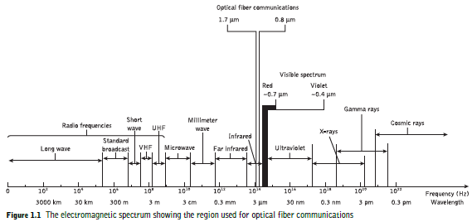

Slide 8
Historical development -4
A renewed interest in optical communication was stimulated in the early 1960s with the invention of the laser.
This device provided a powerful coherent light source, together with the possibility of modulation at high frequency. In addition the low beam divergence of the laser made enhanced free space optical transmission a practical possibility.
However, the previously mentioned constraints of light transmission in the atmosphere tended to restrict these systems to short-distance applications.
Nevertheless, despite the problems some modest free space optical communication links have been implemented for applications such as the linking of a television camera to a base vehicle and for data links of a few hundred meters between buildings.
There is also some interest in optical communication between satellites in outer space using similar techniques.

Slide 9
Historical development -5
Although the use of the laser for free space optical communication proved somewhat limited, the invention of the laser instigated a tremendous research effort into the study of optical components to achieve reliable information transfer using a light wave carrier.
The proposals for optical communication via dielectric waveguides or optical fibers fabricated from glass to avoid degradation of the optical signal by the atmosphere were made almost simultaneously in 1966 by Kao and Hockham and Werts.
Such systems were viewed as a replacement for coaxial cable or carrier transmission systems.
Initially the optical fibers exhibited very high attenuation (i.e. 1000 dB km−1) and were therefore not comparable with the coaxial cables they were to replace (i.e. 5 to 10 dB km−1).
There were also serious problems involved in jointing the fiber cables in a satisfactory manner to achieve low loss and to enable the process to be performed relatively easily and repeatedly
in the field. Nevertheless, within the space of 10 years optical fiber losses were reduced to below 5 dB km−1 and suitable low-loss jointing techniques were perfected.

Slide 10
Historical development -6
In parallel with the development of the fiber waveguide, attention was also focused on the other optical components which would constitute the optical fiber communication system.
Since optical frequencies are accompanied by extremely small wavelengths, the development of all these optical components essentially required a new technology.
Thus semiconductor optical sources (i.e. injection lasers and light-emitting diodes) and detectors (i.e. photodiodes and to a lesser extent phototransistors) compatible in size with optical fibers were designed and fabricated to enable successful implementation of the optical fiber system.
Initially the semiconductor lasers exhibited very short lifetimes of at best a few hours, but significant advances in the device structure enabled lifetimes greater than 1000 h and 7000 h to be obtained by 1973 and 1977 respectively.
These devices were originally fabricated from alloys of gallium arsenide (AlGaAs) which emitted in the near infrared between 0.8 and 0.9 μm.

Slide 11
Historical development -7
Subsequently the above wavelength range was extended to include the 1.1 to 1.6 μm region by the use of other semiconductor alloys to take advantage of the enhanced performance characteristics displayed by optical fibers over this range.
In particular for this longer wavelength region around 1.3 μm and 1.55 μm, semiconductor lasers and also the simpler structured light-emitting diodes based on the quaternary alloy InGaAsP-grown lattice matched to an InP substrate have been available since the late 1980s with projected median lifetimes in excess of 25 years (when operated at 10 °C) for the former and 100 years (when operated at 70 °C) for the latter device types.
Hence the materials growth and fabrication technology has been developed specifically for telecommunication applications and it is now mature.
Moreover, for telecommunication applications such lasers are often provided with a thermoelectric cooler together with a monitoring photodiode in the device package in order to facilitate current and thus temperature control.

Slide 12
Historical development -8
Direct modulation of commercial semiconductor lasers at 2.5 Gbit s−1 over single-mode fiber transmission distances up to 200 km at a wavelength of 1.55 μm can be achieved and this may be extended up to 10 Gbit s−1 over shorter unrepeated fiber links.
Indeed, more recent research and development has focused on 40 Gbit s−1 transmission where external laser modulation is required using, for example, a Mach–Zehnder or an electroabsorption modulator.
This aspect also proves useful in the first longer wavelength window region around 1.3 μm where fiber intramodal dispersion is minimized and hence the transmission bandwidth is maximized, particularly for single-mode fibers.
It is also noteworthy that this fiber type quickly came to dominate system applications within telecommunications since its initial field trial demonstration in 1982.
Moreover, the lowest silica glass fiber losses to date of 0.1484 dB km−1 were reported in 2002 for the other longer wavelength window at 1.57 μm, but, unfortunately, chromatic dispersion is greater at this wavelength, thus limiting the maximum bandwidth achievable with conventional single-mode fiber.

Slide 13
Historical development -9
To obtain low loss over the entire fiber transmission longer wavelength region from 1.3 to 1.6 μm, or alternatively, very low loss and low dispersion at the same operating wavelength of typically 1.55 μm, advanced single-mode fiber structures have been commercially realized: namely, low-water-peak fiber and nonzero dispersion-shifted fiber.
Although developments in fiber technology have continued rapidly over recent years, certain previously favored areas of interest such as the application of fluoride fibers for even longer wavelength operation in the mid-infrared (2 to 5 μm) and far-infrared (8 to 12 μm) regions have declined due to their failure to demonstrate practically the theoretically predicted, extremely low fiber losses combined with the emergence of optical amplifiers suitable for use with silica-based fibers.

Slide 14
Historical development -10
An important development, however, concerns the discovery of the phenomenon of photonic bandgaps which can be created in structures which propagate light, such as crystals or optical fibers.
One particular form of photonic crystal fiber, for example, comprises a microstructured regular lattice of air holes running along its length.
Such ‘holey’ fibers have the unusual property that they only transmit a single mode of light and hence form an entirely new single-mode fiber type which can carry more optical power than a conventional one.

Slide 15
Historical development -11
A further class of photonic bandgap fiber is defined by a large hollow core in which the light is guided.
Such air guiding or hollow-core optical fibers could find application in photonic bandgap devices to provide dispersion compensation on long-haul fiber links or for high-resolution, tunable spectral filters.
Nevertheless, even without the commercial availability of photonic bandgap devices, the implementation of a wide range of conventional fiber components (splices, connectors, couplers, etc.) and active optoelectronic devices (sources, detectors, amplifiers, etc.) has also moved to a stage of maturity.
High-performance, reliable optical fiber communication systems and networks are therefore now widely deployed within the worldwide telecommunication network and in many more localized communication application areas.

Slide 16
The general system-1
An optical fiber communication system is similar in basic concept to any type of communication system.
A block schematic of a general communication system is shown in Figure 1.2(a), the function of which is to convey the signal from the information source over the transmission medium to the destination.
The communication system therefore consists of a transmitter or modulator linked to the information source, the transmission medium, and a receiver or demodulator at the destination point.
In electrical communications the information source provides an electrical signal, usually derived from a message signal which is not electrical (e.g. sound), to a transmitter comprising electrical and electronic components which converts the signal into a suitable form for propagation over the transmission medium.
This is often achieved by modulating a carrier, which, as mentioned previously, may be an electromagnetic wave.

Slide 17
The general system-2
The transmission medium can consist of a pair of wires, a coaxial cable or a radio link through free space down which the signal is transmitted to the receiver, where it is transformed into the original electrical information signal (demodulated) before being passed to the destination.
However, it must be noted that in any transmission medium the signal is attenuated, or suffers loss, and is subject to degradations due to contamination by random signals and noise, as well as possible distortions imposed by mechanisms within the medium itself.
Therefore, in any communication system there is a maximum permitted distance between the transmitter and the receiver beyond which the system effectively ceases to give intelligible communication.
For longhaul applications these factors necessitate the installation of repeaters or line amplifier at intervals, both to remove signal distortion and to increase signal level before transmission is continued down the link.

Slide 18
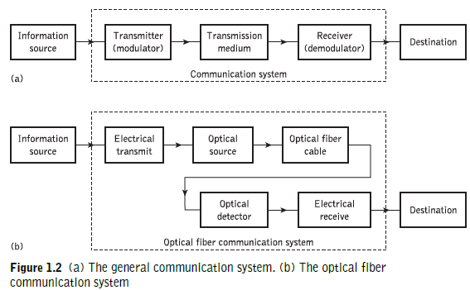
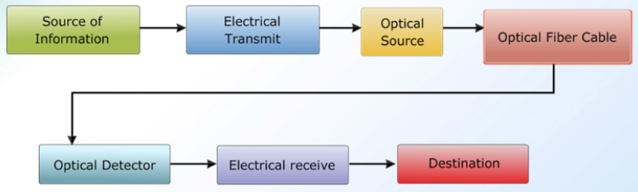
The general system-3

Slide 19
The general system-4
For optical fiber communications the system shown in Figure 1.2(a) may be considered in slightly greater detail, as given in Figure 1.2(b).
In this case the information source provides an electrical signal to a transmitter comprising an electrical stage which drives an optical source to give modulation of the lightwave carrier.
The optical source which provides the electrical–optical conversion may be either a semiconductor laser or light-emitting diode (LED).
The transmission medium consists of an optical fiber cable and the receiver consists of an optical detector which drives a further electrical stage and hence provides demodulation of the optical carrier.
Photodiodes (p–n, p–i–n or avalanche) and, in some instances, phototransistors and photoconductors are utilized for the detection of the optical signal and the optical–electrical conversion.
Thus there is a requirement for electrical interfacing at either end of the optical link and at present the signal processing is usually performed electrically.

Slide 20
The general system-5
The optical carrier may be modulated using either an analog or digital information signal.
In the system shown in Figure 1.2(b) analog modulation involves the variation of the light emitted from the optical source in a continuous manner.
With digital modulation, however, discrete changes in the light intensity are obtained (i.e. on–off pulses).
Although often simpler to implement, analog modulation with an optical fiber communication system is less efficient, requiring a far higher signal-to-noise ratio at the receiver than digital modulation.
Also, the linearity needed for analog modulation is not always provided by semiconductor optical sources, especially at high modulation frequencies.
For these reasons, analog optical fiber communication links are generally limited to shorter distances and lower bandwidth operation than digital links.

Slide 21
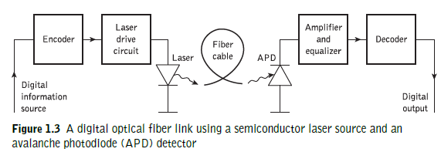
The general system-6

Slide 22
The general system-7
Figure 1.3 shows a block schematic of a typical digital optical fiber link.
Initially, the input digital signal from the information source is suitably encoded for optical transmission.
The laser drive circuit directly modulates the intensity of the semiconductor laser with the encoded digital signal.
Hence a digital optical signal is launched into the optical fiber cable.
The avalanche photodiode (APD) detector is followed by a front-end amplifier and equalizer or filter to provide gain as well as linear signal processing and noise bandwidth reduction.
Finally, the signal obtained is decoded to give the original digital information.
However, at this stage it is instructive to consider the advantages provided by lightwave communication via optical fibers in comparison with other forms of line and radio communication which have brought about the extensive use of such systems in many areas throughout the world.

Slide 23
1.3 Advantages of optical fiber communication-1
Communication using an optical carrier wave guided along a glass fiber has a number of extremely attractive features, several of which were apparent when the technique was originally conceived.
Furthermore, the advances in the technology to date have surpassed even the most optimistic predictions, creating additional advantages.
Hence it is useful to consider the merits and special features offered by optical fiber communications over more conventional electrical communications.
In this context we commence with the originally foreseen advantages and then consider additional features which have become apparent as the technology has been developed.

Slide 24




Advantages of optical fiber communication-2
(a) Enormous potential bandwidth.
The optical carrier frequency in the range to Hz (generally in the near infrared around GHz or GHz) yields a far greater potential transmission bandwidth than metallic cable systems (i.e. coaxial cable bandwidth typically around 20 MHz over distances up to a maximum of 10 km) or even millimeter wave radio systems (i.e. systems currently operating with modulation bandwidths of 700 MHz over a few hundreds of meters).
Indeed, by the year 2000 the typical bandwidth multiplied by length product for an optical fiber link incorporating fiber amplifiers was 5000 GHz km in comparison with the typical bandwidth–length product for coaxial cable of around 100 MHz km.
Hence at this time optical fiber was already demonstrating a factor of 50 000 bandwidth improvement over coaxial cable while also providing this superior information-carrying capacity over much longer transmission distances.

Slide 25
Advantages of optical fiber communication-2
(a) Enormous potential bandwidth.
The optical carrier frequency in the range to Hz (generally in the near infrared around GHz or GHz) yields a far greater potential transmission bandwidth than metallic cable systems (i.e. coaxial cable bandwidth typically around 20 MHz over distances up to a maximum of 10 km) or even millimeter wave radio systems (i.e. systems currently operating with modulation bandwidths of 700 MHz over a few hundreds of meters).
Indeed, by the year 2000 the typical bandwidth multiplied by length product for an optical fiber link incorporating fiber amplifiers was 5000 GHz km in comparison with the typical bandwidth–length product for coaxial cable of around 100 MHz km.
Hence at this time optical fiber was already demonstrating a factor of 50 000 bandwidth improvement over coaxial cable while also providing this superior information-carrying capacity over much longer transmission distances.

Slide 26
Advantages of optical fiber communication-3
Although the usable fiber bandwidth will be extended further towards the optical carrier frequency, it is clear that this parameter is limited by the use of a single optical carrier signal.
Hence a much enhanced bandwidth utilization for an optical fiber can be achieved by transmitting several optical signals, each at different center wavelengths, in parallel on the same fiber.
This wavelength division multiplexed operation, particularly with dense packing of the optical wavelengths (or, essentially, fine frequency spacing), offers the potential for a fiber information-carrying capacity that is many orders of magnitude in excess of that obtained using copper cables or a wideband radio system.

Slide 27
Advantages of optical fiber communication-4
(b) Small size and weight. Optical fibers have very small diameters which are often no greater than the diameter of a human hair.
Hence, even when such fibers are covered with protective coatings they are far smaller and much lighter than corresponding copper cables.
This is a tremendous boon towards the alleviation of duct congestion in cities, as well as allowing for an expansion of signal transmission within mobiles such as aircraft,satellites and even ships.

Slide 28
Advantages of optical fiber communication-5
(c) Electrical isolation.
Optical fibers which are fabricated from glass, or sometimes a plastic polymer, are electrical insulators and therefore, unlike their metallic counterparts, they do not exhibit earth loop and interface problems.
Furthermore, this property makes optical fiber transmission ideally suited for communication in electrically hazardous environments as the fibers create no arcing or spark hazard at abrasions or short circuits.

Slide 29
Advantages of optical fiber communication-6
(d) Immunity to interference and crosstalk. Optical fibers form a dielectric waveguide and are therefore free from electromagnetic interference (EMI), radio-frequency interference (RFI), or switching transients giving electromagnetic pulses (EMPs).
Hence the operation of an optical fiber communication system is unaffected by transmission through an electrically noisy environment and the fiber cable requires no shielding from EMI.
The fiber cable is also not susceptible to lightning strikes if used overhead rather than underground.
Moreover, it is fairly easy to ensure that there is no optical interference between fibers and hence, unlike communication using electrical conductors, crosstalk is negligible, even when many fibers are cabled together.

Slide 30
Advantages of optical fiber communication-7
(e) Signal security.
The light from optical fibers does not radiate significantly and therefore they provide a high degree of signal security.
Unlike the situation with copper cables, a transmitted optical signal cannot be obtained from a fiber in a noninvasive manner
(i.e. without drawing optical power from the fiber).
Therefore, in theory, any attempt to acquire a message signal transmitted optically may be detected.
This feature is obviously attractive for military, banking and general data transmission (i.e. computer network) applications.

Slide 31
Advantages of optical fiber communication-8
(f) Low transmission loss. The development of optical fibers over the last 20 years has resulted in the production of optical fiber cables which exhibit very low attenuation or transmission loss in comparison with the best copper conductors.
Fibers have been fabricated with losses as low as 0.15 dB km−1 and this feature has become a major advantage of optical fiber communications.
It facilitates the implementation of communication links with extremely wide optical repeater or amplifier spacings, thus reducing both system cost and complexity.
Together with the already proven modulation bandwidth capability of fiber cables, this property has provided a totally compelling case for the adoption of optical fiber communications in the majority of long-haul telecommunication applications, replacing not only copper cables, but also satellite communications, as a consequence of the very noticeable delay incurred for voice transmission when using this latter approach.

Slide 32
Advantages of optical fiber communication-9
(g) Ruggedness and flexibility. Although protective coatings are essential, optical fibers may be manufactured with very high tensile strengths.
Perhaps surprisingly for a glassy substance, the fibers may also be bent to quite small radii or twisted without damage.
Furthermore, cable structures have been developed, which have proved flexible, compact and extremely rugged.
Taking the size and weight advantage into account, these optical fiber cables are generally superior in terms of storage, transportation, handling and installation to corresponding copper cables, while exhibiting at least comparable strength and durability.

Slide 33
Advantages of optical fiber communication-10
(h) System reliability and ease of maintenance. These features primarily stem from the low-loss property of optical fiber cables which reduces the requirement for intermediate repeaters or line amplifiers to boost the transmitted signal strength.
Hence with fewer optical repeaters or amplifiers, system reliability is generally enhanced in comparison with conventional electrical conductor systems.
Furthermore, the reliability of the optical components is no longer a problem with predicted lifetimes of 20 to 30 years being quite common.
Both these factors also tend to reduce maintenance time and costs.

Slide 34
Advantages of optical fiber communication-11
(i) Potential low cost. The glass which generally provides the optical fiber transmission medium is made from sand – not a scarce resource. So, in comparison with copper conductors, optical fibers offer the potential for low-cost line communication.
Although over recent years this potential has largely been realized in the costs of the optical fiber transmission medium which for bulk purchases has become competitive with copper wires (i.e. twisted pairs), it has not yet been achieved in all the other component areas associated with optical fiber communications.
For example, the costs of high-performance semiconductor lasers and detector photodiodes are still relatively high, as well as some of those concerned with the connection technology (demountable connectors, couplers, etc.).

Slide 35
Advantages of optical fiber communication-12
Overall system costs when utilizing optical fiber communication on long-haul links, however, are substantially less than those for equivalent electrical line systems because of the low-loss and wideband properties of the optical transmission medium.
As indicated in (f), the requirement for intermediate repeaters and the associated electronics is reduced, giving a substantial cost advantage.
Although this cost benefit gives a net gain for longhaul links, it is not always the case in short-haul applications where the additional cost incurred, due to the electrical–optical conversion (and vice versa), may be a deciding factor.
Nevertheless, there are other possible cost advantages in relation to shipping, handling, installation and maintenance, as well as the features indicated in (c) and (d) which may prove significant in the system choice.

Slide 36
Advantages of optical fiber communication-13
The reducing costs of optical fiber communications has provided strong competition not only with electrical line transmission systems, but also for microwave and millimeter wave radio transmission systems.
Although these systems are reasonably wideband, the relatively short-span ‘line of sight’ transmission necessitates expensive aerial towers at intervals no greater than a few tens of kilometers.
Hence, with the exception of the telecommunication access network due primarily to current first installed cost constraints, optical fiber has become the dominant transmission medium within the major industrialized societies.
Many advantages are therefore provided by the use of a lightwave carrier within a transmission medium consisting of an optical fiber.
The fundamental principles giving rise to these enhanced performance characteristics, together with their practical realization, are described in the following chapters.
However, a general understanding of the basic nature and properties of light is assumed.
If this is lacking, the reader is directed to the many excellent texts encompassing the topic, a few of which are indicated in Refs 19 to 23.

Slide 37
Optical fiber Waveguides:- Introduction-1
The transmission of light via a dielectric waveguide structure was first proposed and investigated at the beginning of the twentieth century.
In 1910 Hondros and Debye conducted a theoretical study, and experimental work was reported by Schriever in 1920.
However, a transparent dielectric rod, typically of silica glass with a refractive index of around 1.5, surrounded by air, proved to be an impractical waveguide due to its unsupported structure (especially when very thin waveguides were considered in order to limit the number of optical modes propagated) and the excessive losses at any discontinuities of the glass–air interface.

Slide 38
Optical fiber Waveguides:- Introduction-2
Nevertheless, interest in the application of dielectric optical waveguides in such areas as optical imaging and medical diagnosis (e.g. endoscopes) led to proposals for a clad dielectric rod in the mid-1950s in order to overcome these problems.
This structure is illustrated in Figure 2.1, which shows a transparent core with a refractive index n1 surrounded by a transparent cladding of slightly lower refractive index n2.
The cladding supports the waveguide structure while also, when sufficiently thick, substantially reducing the radiation loss into the surrounding air.
In essence, the light energy travels in both the core and the cladding allowing the associated fields to decay to a negligible value at the cladding–air interface.

Slide 39
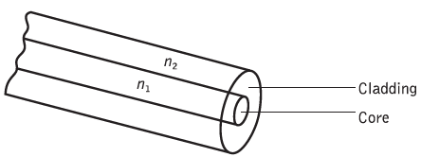
Optical fiber Waveguides:- Introduction-3
Figure 2.1 Optical fiber waveguide showing the core of refractive index n1, surrounded by the cladding of slightly lower refractive index n2

Slide 40
Optical fiber Waveguides:- Introduction-4
The invention of the clad waveguide structure led to the first serious proposals by Kao and Hockham and Werts, in 1966, to utilize optical fibers as a communications medium, even though they had losses in excess of 1000 dB km−1.
These proposals stimulated tremendous efforts to reduce the attenuation by purification of the materials.
This has resulted in improved conventional glass refining techniques giving fibers with losses of around 4.2 dB km−1.
Also, progress in glass refining processes such as depositing vapor-phase reagents to form silica allowed fibers with losses below 1 dB km−1 to be fabricated.

Slide 41
Optical fiber Waveguides:- Introduction-5
Most of this work was focused on the 0.8 to 0.9 μm wavelength band because the first generation of optical sources fabricated from gallium aluminum arsenide alloys operated in this region.
However, as silica fibers were studied in further detail it became apparent that transmission at longer wavelengths (1.1 to 1.6 μm) would result in lower losses and reduced signal dispersion.
This produced a shift in optical fiber source and detector technology in order to provide operation at these longer wavelengths.
Hence at longer wavelengths, especially around 1.55 μm, typical high-performance fibers have losses of 0.2 dB km−1.

Slide 42
Optical fiber Waveguides:- Introduction-6
As such losses are very close to the theoretical lower limit for silicate glass fiber, there is interest in glass-forming systems which can provide low-loss transmission in the mid-infrared (2 to 5 μm) optical wavelength regions.
Although a system based on fluoride glass offers the potential for ultra-low-loss transmission of 0.01 dB km−1 at a wavelength of 2.55 μm, such fibers still exhibit losses of at least 0.65 dB km−1 and they also cannot yet be produced with the robust mechanical properties of silica fibers.

Slide 43
Optical fiber Waveguides:- Introduction-7
In order to appreciate the transmission mechanism of optical fibers with dimensions approximating to those of a human hair, it is necessary to consider the optical waveguiding of a cylindrical glass fiber.
Such a fiber acts as an open optical waveguide, which may be analyzed utilizing simple ray theory.
However, the concepts of geometric optics are not sufficient when considering all types of optical fiber, and electromagnetic mode theory must be used to give a complete picture.

Slide 44
Optical fiber Waveguides:- Introduction-8
All consideration in the above sections is concerned with what can be referred to as conventional optical fiber in the context that it comprises both solid-core and cladding regions as depicted in Figure 2.1.
In the mid-1990s, however, a new class of micro-structured optical fiber, termed photonic crystal fiber, was experimentally demonstrated, which has subsequently exhibited the potential to deliver applications ranging from light transmission over distance to optical device implementations (e.g. power splitters, amplifiers, bistable switches, wavelength converters).
The significant physical feature of this microstructured optical fiber is that it typically contains an array of air holes running along the longitudinal axis rather than consisting of a solid silica rod structure.
Moreover, the presence of these holes provides an additional dimension to fiber design which has already resulted in new developments for both guiding and controlling light.

Slide 45
Optical fiber Waveguides:- Ray theory transmission- Total internal reflection-1:
To consider the propagation of light within an optical fiber utilizing the ray theory model it is necessary to take account of the refractive index of the dielectric medium.
The refractive index of a medium is defined as the ratio of the velocity of light in a vacuum to the velocity of light in the medium.
A ray of light travels more slowly in an optically dense medium than in one that is less dense, and the refractive index gives a measure of this effect.
When a ray is incident on the interface between two dielectrics of differing refractive indices(eg.glass–air),refraction occurs, as illustrated in Figure 2.2(a).
It may be observed that the ray approaching the interface is propagating in a dielectric of refractive index n1 and is at an angle φ1 to the normal at the surface of the interface.
If the dielectric on the other side of the interface has a refractive index n2 which is less than n1, then the refraction is such that the ray path in this lower index medium is at an angle φ2 to the normal, where φ2 is greater than φ1.

Slide 46
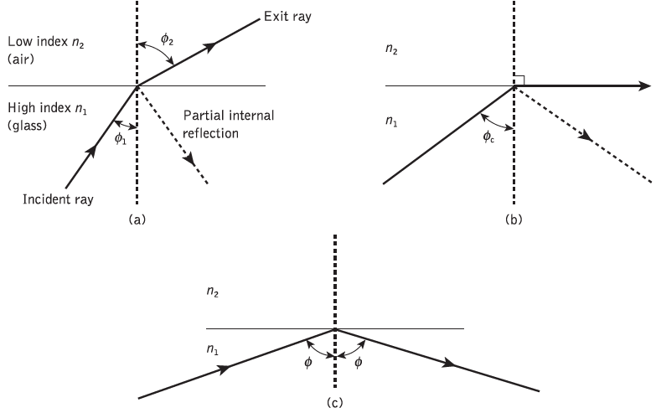
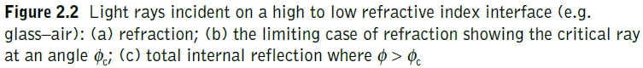
Optical fiber Waveguides:- Ray theory transmission- Total internal reflection-2:

Slide 47
Optical fiber Waveguides:- Ray theory transmission- Total internal reflection-3:
The angles of incidence φ1 and refraction φ2 are related to each other and to the refractive indices of the dielectrics by Snell’s law of refraction, which states that:
n1 sin φ1 = n2 sin φ2 or sin φ1 / sin φ2 = n2 / n1 (2.1)
It may also be observed in Figure 2.2(a) that a small amount of light is reflected back into the originating dielectric medium (partial internal reflection).
As n1 is greater than n2, the angle of refraction is always greater than the angle of incidence. (φ2 is greater than φ1 )
Thus, when the angle of refraction (φ2) is 90° and the refracted ray emerges parallel to the interface between the dielectrics, the angle of incidence must be less than 90° (φ1 ˂ 90° ).
This is the limiting case of refraction and the angle of incidence is now known as the critical angle φc, as shown in Figure 2.2(b).
From Eq. (2.1) the value of the critical angle is given by:
sin φc = n2 / n1 or φc = Sin-1 (n2 /n1) (2.2)

Slide 48
Optical fiber Waveguides:- Ray theory transmission- Total internal reflection-4:
At angles of incidence greater than the critical angle the light is reflected back into the originating dielectric medium (total internal reflection) with high efficiency (around 99.9%).
Hence, it may be observed in Figure 2.2(c) that total internal reflection occurs at the interface between two dielectrics of differing refractive indices when light is incident on the dielectric of lower index from the dielectric of higher index, and the angle of incidence of the ray exceeds the critical value.
This is the mechanism by which light at a sufficiently shallow angle (less than 90° − φc) may be considered to propagate down an optical fiber with low loss.
Figure 2.3 illustrates the transmission of a light ray in an optical fiber via a series of total internal reflections at the interface of the silica core and the slightly lower refractive index silica cladding.
The ray has an angle of incidence φ at the interface which is greater than the critical angle and is reflected at the same angle to the normal.

Slide 49
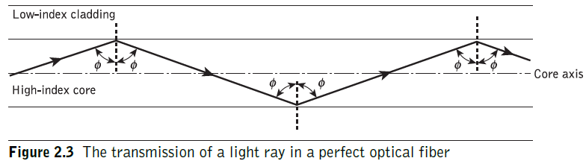
Optical fiber Waveguides:- Ray theory transmission- Total internal reflection-5:

Slide 50
Optical fiber Waveguides:- Ray theory transmission- Total internal reflection-6:
The light ray shown in Figure 2.3 is known as a meridional ray as it passes through the axis of the fiber core.
This type of ray is the simplest to describe and is generally used when illustrating the fundamental transmission properties of optical fibers.
It must also be noted that the light transmission illustrated in Figure 2.3 assumes a perfect fiber, and that any discontinuities or imperfections at the core–cladding interface would probably result in refraction rather than total internal reflection, with the subsequent loss of the light ray into the cladding.

Slide 51
Optical fiber Waveguides:- Ray theory transmission- Acceptance angle-1
Having considered the propagation of light in an optical fiber through total internal reflection at the core–cladding interface, it is useful to enlarge upon the geometric optics approach with reference to light rays entering the fiber.
Since only rays with a sufficiently shallow grazing angle (i.e. with an angle to the normal greater than φc) at the core–cladding interface are transmitted by total internal reflection, it is clear that not all rays entering the fiber core will continue to be propagated down its length.

Slide 52
Optical fiber Waveguides:- Ray theory transmission- Acceptance angle-2
The geometry concerned with launching a light ray into an optical fiber is shown in Figure 2.4, which illustrates a meridional ray A at the critical angle φc within the fiber at the core–cladding interface.
It may be observed that this ray enters the fiber core at an angle θa to the fiber axis and is refracted at the air–core interface before transmission to the core–cladding interface at the critical angle.
Hence, any rays which are incident into the fiber core at an angle greater than θa will be transmitted to the core–cladding interface at an angle less than φc, and will not be totally internally reflected.
This situation is also illustrated in Figure 2.4, where the incident ray B at an angle greater than θa is refracted into the cladding and eventually lost by radiation.

Slide 53
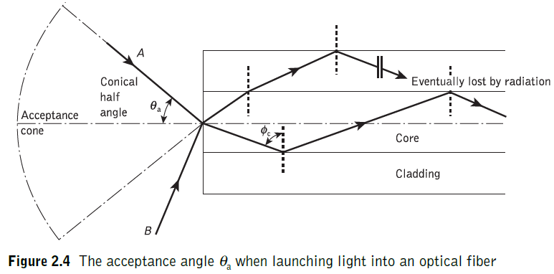
Optical fiber Waveguides:- Ray theory transmission- Acceptance angle-3

Slide 54
Optical fiber Waveguides:- Ray theory transmission- Acceptance angle-4
Thus for rays to be transmitted by total internal reflection within the fiber core they must be incident on the fiber core within an acceptance cone defined by the conical half angle θa.
Hence θa is the maximum angle to the axis at which light may enter the fiber in order to be propagated, and is often referred to as the acceptance angle* for the fiber.
* θa is sometimes referred to as the maximum or total acceptance angle.
If the fiber has a regular cross-section (i.e. the core–cladding interfaces are parallel and there are no discontinuities) an incident meridional ray at greater than the critical angle will continue to be reflected and will be transmitted through the fiber.
From symmetry considerations it may be noted that the output angle to the axis will be equal to the input angle for the ray, assuming the ray emerges into a medium of the same refractive index from which it was input.

Slide 55
Optical fiber Waveguides:- Ray theory transmission- Numerical Aperture-1
The acceptance angle for an optical fiber was defined in the preceding section.
However, it is possible to continue the ray theory analysis to obtain a relationship between the acceptance angle and the refractive indices of the three media involved, namely the core,cladding and air.
This leads to the definition of a more generally used term, the numerical aperture of the fiber.
It must be noted that within this analysis, as with the preceding discussion of acceptance angle, we are concerned with meridional rays within the fiber.

Slide 56
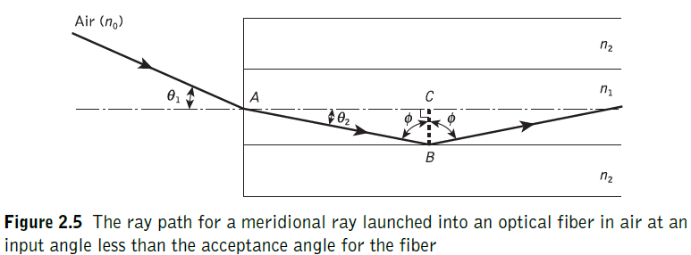
Optical fiber Waveguides:- Ray theory transmission- Numerical Aperture-2

Slide 57
Optical fiber Waveguides:- Ray theory transmission- Numerical Aperture-3
Figure 2.5 shows a light ray incident on the fiber core at an angle θ1 to the fiber axis which is less than the acceptance angle for the fiber θa.
The ray enters the fiber from a medium (air) of refractive index n0, and the fiber core has a refractive index n1, which is slightly greater than the cladding refractive index n2.
Assuming the entrance face at the fiber core to be normal to the axis, then considering the refraction at the air–core interface and using Snell’s law given by Eq. (2.1):
n0 sin θ1 = n1 sin θ2 (2.3)
Considering the right-angled triangle ABC indicated in Figure 2.5, then:
φ= (π/2)− θ2 (2.4)
where φ is greater than the critical angle at the core–cladding interface.
θ2 = (π/2)− φ
Hence Eq. (2.3) becomes:
n0 sin θ1 = n1 cos φ (2.5)

Slide 58
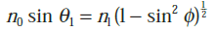
Optical fiber Waveguides:- Ray theory transmission- Numerical Aperture-4
Using the trigonometrical relationship , Eq. (2.5) may be written in the form:
(2.6)
When the limiting case for total internal reflection is considered, φ becomes equal to the critical angle for the core–cladding interface and is given by Eq. (2.2).
Also in this limiting case θ1 becomes the acceptance angle for the fiber θa.
Combining these limiting cases into Eq. (2.6) gives
(2.7)
Equation (2.7), apart from relating the acceptance angle to the refractive indices, serves as the basis for the definition of the important optical fiber parameter, the numerical aperture (NA). Hence the NA is defined as:
(2.8)
Since the NA is often used with the fiber in air where n0 is unity, it is simply equal to sin θa.
It may also be noted that incident meridional rays over the range 0 ≤ θ1 ≤ θa will be propagated within the fiber.

Slide 59
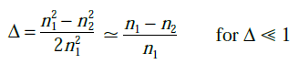
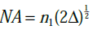
Optical fiber Waveguides:- Ray theory transmission- Numerical Aperture-5
The NA may also be given in terms of the relative refractive index difference Δ between the core and the cladding which is defined as:*
(2.9)
Hence combining Eq. (2.8) with Eq. (2.9) we can write: (2.10)
The relationships given in Eqs (2.8) and (2.10) for the numerical aperture are a very useful measure of the light-collecting ability of a fiber.
They are independent of the fiber core diameter and will hold for diameters as small as 8 μm.

Slide 60
Optical fiber Waveguides:- Ray theory transmission- Numerical Aperture-6
However, for smaller diameters they break down as the geometric optics approach is invalid.
This is because the ray theory model is only a partial description of the character of light.
It describes the direction a plane wave component takes in the fiber but does not take into account interference between such components.
When interference phenomena are considered it is found that only rays with certain discrete characteristics propagate in the fiber core.
Thus the fiber will only support a discrete number of guided modes. This becomes critical in smallcore-diameter fibers which only support one or a few modes.
Hence electromagnetic mode theory must be applied in these cases.

Slide 61
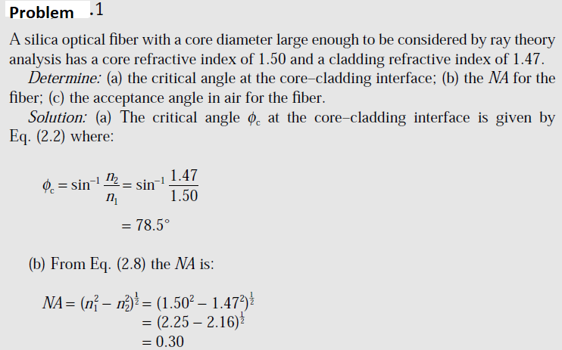
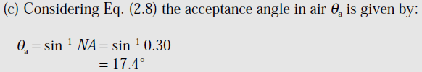

Slide 62
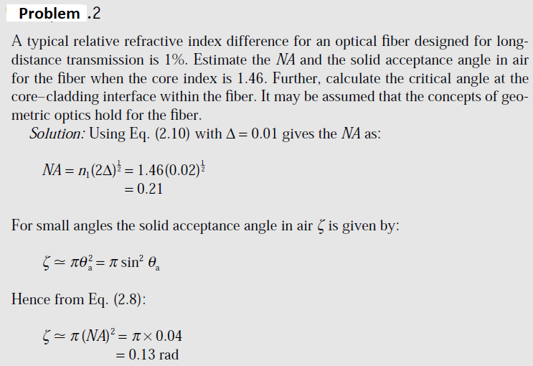

Slide 63
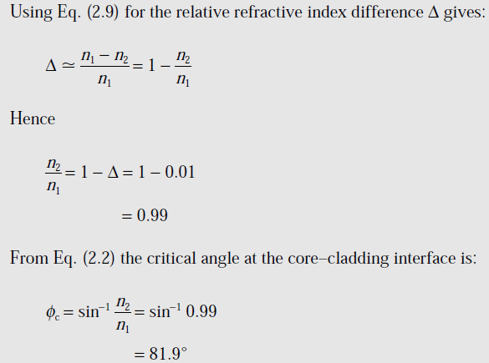

Slide 64
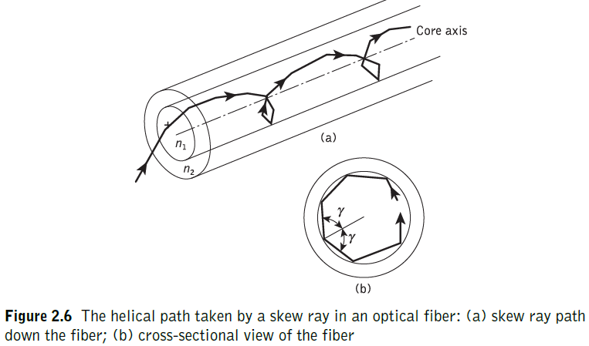
Optical fiber Waveguides:- Ray theory transmission- Skew Rays-1
In the preceding sections we have considered the propagation of meridional rays in the optical waveguide.
However, another category of ray exists which is transmitted without passing through the fiber axis.
These rays, which greatly outnumber the meridional rays, follow a helical path through the fiber, as illustrated in Figure 2.6, and are called skew rays.

Slide 65
Optical fiber Waveguides:- Ray theory transmission- Skew Rays-2
It is not easy to visualize the skew ray paths in two dimensions, but it may be observed from Figure 2.6(b) that the helical path traced through the fiber gives a change in direction of 2γ at each reflection, where γ is the angle between the projection of the ray in two dimensions and the radius of the fiber core at the point of reflection.
Hence, unlike meridional rays, the point of emergence of skew rays from the fiber in air will depend upon the number of reflections they undergo rather than the input conditions to the fiber.
When the light input to the fiber is nonuniform, skew rays will therefore tend to have a smoothing effect on the distribution of the light as it is transmitted, giving a more uniform output.
The amount of smoothing is dependent on the number of reflections encountered by the skew rays.

Slide 66
Optical fiber Waveguides:- Ray theory transmission- Skew Rays-3
A further possible advantage of the transmission of skew rays becomes apparent when their acceptance conditions are considered.
In order to calculate the acceptance angle for a skew ray it is necessary to define the direction of the ray in two perpendicular planes.
The geometry of the situation is illustrated in Figure 2.7 where a skew ray is shown incident on the fiber core at the point A, at an angle θs to the normal at the fiber end face.
The ray is refracted at the air–core interface before traveling to the point B in the same plane.
The angles of incidence and reflection at the point B are φ, which is greater than the critical angle for the core–cladding interface.

Slide 67
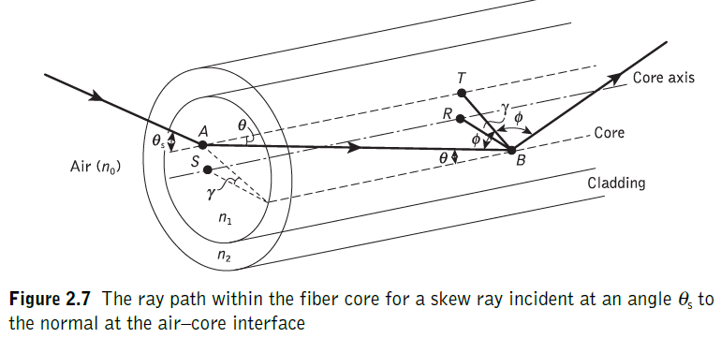
Optical fiber Waveguides:- Ray theory transmission- Skew Rays-4

Slide 68
Optical fiber Waveguides:- Ray theory transmission- Skew Rays-5
When considering the ray between A and B it is necessary to resolve the direction of the ray path AB to the core radius at the point B.
As the incident and reflected rays at the point B are in the same plane, this is simply cos φ.
However, if the two perpendicular planes through which the ray path AB traverses are considered, then γ is the angle between the core radius and the projection of the ray onto a plane BRS normal to the core axis, and θ is the angle between the ray and a line AT drawn parallel to the core axis.
Thus to resolve the ray path AB relative to the radius BR in these two perpendicular planes requires multiplication by cos γ and sin θ.

Slide 69
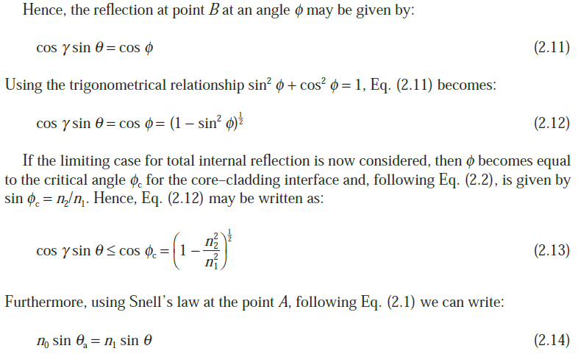
Optical fiber Waveguides:- Ray theory transmission- Skew Rays-6

Slide 70
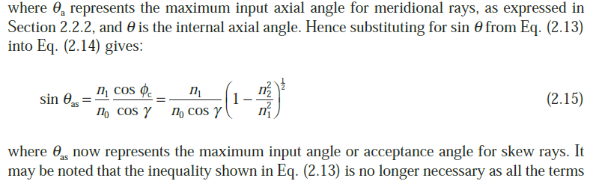
Optical fiber Waveguides:- Ray theory transmission- Skew Rays-7

Slide 71
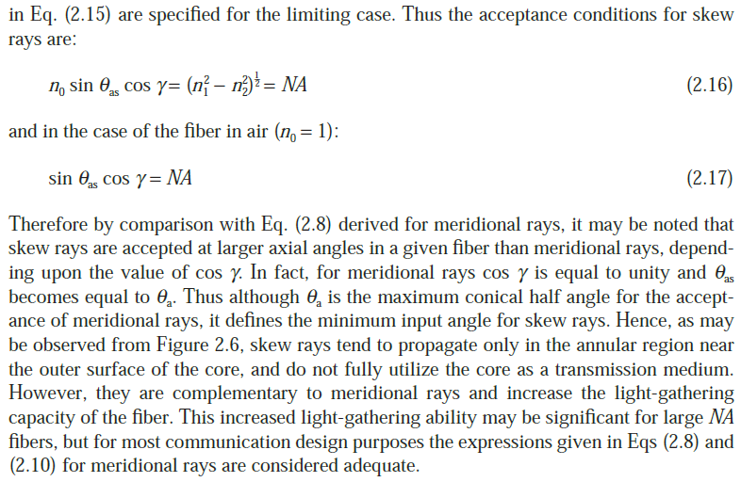
Optical fiber Waveguides:- Ray theory transmission- Skew Rays-8

Slide 72
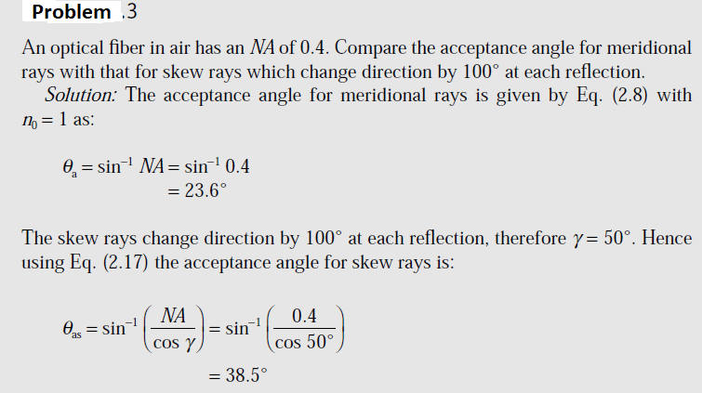
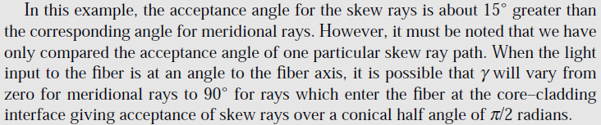

Slide 73
Cylindrical fiber-1
Modes:
Upto now we have studied the propagation of light inside an optical fiber using ray theory. But this approach does not give information about Electromagnetic field configuration inside the fiber. Therefore mode theory is used to describe the properties of light that ray theory is unable to explain.
Modes in Planar Waveguide:
The planar guide is the simplest form of optical waveguide. We may assume it consists of a slab of dielectric with refractive index n1 sandwiched between two regions of lower refractive index n2.
Consider plane monochromatic wave propagating in the direction of the ray path within the guide as shown in Figure 2.8(a).
As the refractive index within the guide is n1, the optical wavelength in this region is reduced to λ/n1, while the vacuum propagation constant is increased to n1k.

Slide 74
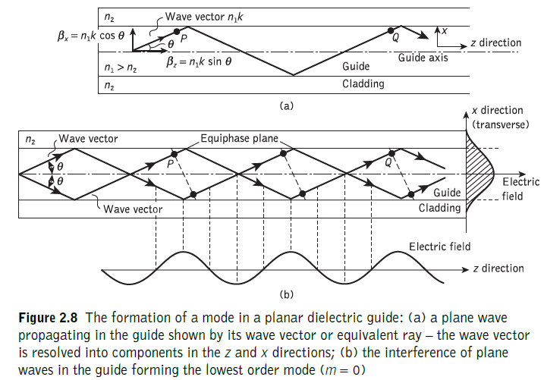
Cylindrical fiber-2

Slide 75
Cylindrical fiber-3
When θ is the angle between the wave propagation vector or the equivalent ray and the guide axis, the plane wave can be resolved into two component plane waves propagating in the z and x directions, as shown in Figure 2.8(a).
The component of the phase propagation constant in the z direction βz is given by:
The component of the phase propagation constant in the x direction βx is:
Electric field penetrates some distance into cladding. Electric field distribution in the x direction does not change as the wave propagates in the z direction.
The sinusoidally varying electric field in the z direction is also shown in Figure 2.8(b). The stable field distribution in the x direction with only a periodic z dependence is known as a mode.

Slide 76
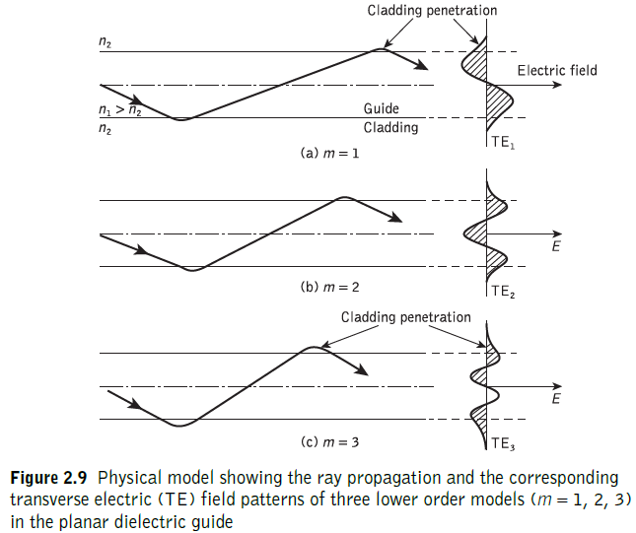
Cylindrical fiber-4

Slide 77
Cylindrical fiber-5
Fig. 2.9 shows the plane waves corresponding to rays at different specific angles in planar guide.
Rays for m = 1, 2, 3 are shown together with the electric field distributions in the x direction.
It may be observed that m denotes the number of zeros in this transverse field pattern. In this way m signifies the order of the mode and is known as the mode number.

Slide 78
Modes of Cylindrical Waveguide-1
The cylindrical waveguide, however, is bounded in two dimensions rather than one. Thus two integers, l and m, are necessary in order to specify the modes.
For the cylindrical waveguide TEm and TMm modes correspond to meridional rays traveling within the fiber.
However, hybrid modes where Ez and Hz are nonzero also occur within the cylindrical waveguide.
These modes, which result from skew ray propagation within the fiber, are designated HElm and EHlm depending upon whether the components of H or E make the larger contribution to the transverse (to the fiber axis) field.

Slide 79
Modes of Cylindrical Waveguide-2
Fibers used for communication purposes follow weakly guiding approximations where refractive index Δ << 1. This corresponds to small grazing angles θ in Eq. (2.34). In fact Δ is usually less than 0.03 (3%) for optical communications fibers.
For weakly guiding structures with dominant forward propagation, mode theory gives dominant transverse field components.
Hence approximate solutions for the full set of HE, EH, TE and TM modes may be given by two linearly polarized components.
These linearly polarized (LP) modes are not exact modes of the fiber except for the fundamental (lowest order) mode.
However, as Δ in weakly guiding fibers is very small, then HE–EH mode pairs occur which have almost identical propagation constants.
Such modes are said to be degenerate.

Slide 80
Modes of Cylindrical Waveguide-3
The superpositions of these degenerating modes characterized by a common propagation constant correspond to particular LP modes regardless of their HE, EH, TE or TM field configurations.
This linear combination of degenerate modes obtained from the exact solution produces a useful simplification in the analysis of weakly guiding fibers.
The relationship between the traditional HE, EH, TE and TM mode designations and the LPlm mode designations is shown in Table 2.1.
The mode subscripts l and m are related to the electric field intensity profile for a particular LP mode (see Figure 2.15(d)).
There are in general 2l field maxima around the circumference of the fiber core and m field maxima along a radius vector.
Furthermore, it may be observed from Table 2.1 that the notation for labeling the HE and EH modes has changed from that specified for the exact solution in the cylindrical waveguide mentioned previously.
The subscript l in the LP notation now corresponds to HE and EH modes with labels l + 1 and l − 1 respectively.

Slide 81
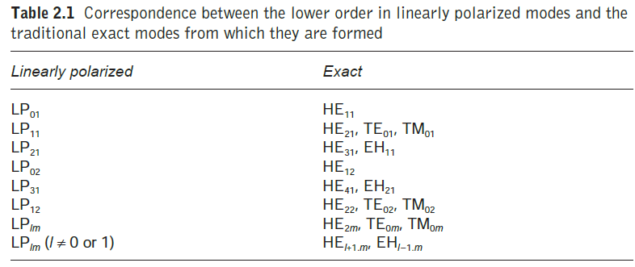

Slide 82
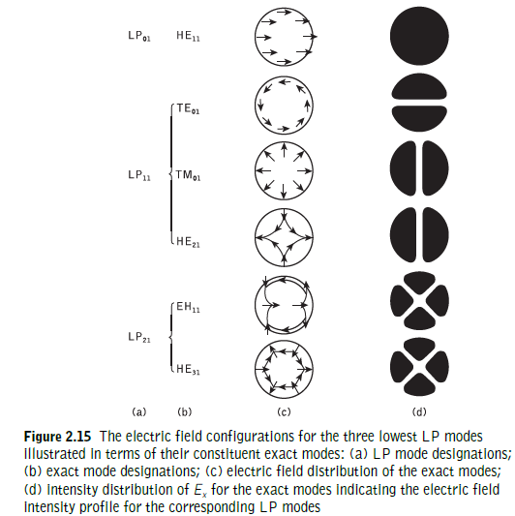

Slide 83
Modes of Cylindrical Waveguide-4
The electric field intensity profiles for the lowest three LP modes, together with the electric field distribution of their constituent exact modes, are shown in Figure 2.15.
It may be observed from the field configurations of the exact modes that the field strength in the transverse direction (Ex or Ey) is identical for the modes which belong to the same LP mode.
Hence the origin of the term ‘linearly polarized’.

Slide 84
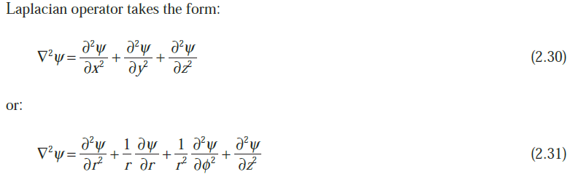
Modes of Cylindrical Waveguide-5
Using Eq. (2.31) for the cylindrical homogeneous core waveguide under the weak guidance conditions outlined above, the scalar wave equation can be written in the form
where ψ is the field (E or H), n1 is the refractive index of the fiber core, k is the propagation constant for light in a vacuum, and r and φ are cylindrical coordinates.
The propagation constants of the guided modes β lie in the range:
where n2 is the refractive index of the fiber cladding.

Slide 85
Types of Modes
1) Guided Mode:
Modes that propagate axially down the fiber are called Guided modes. A mode remains guided as long as β satisfies the condition
n2k < β < n1k
Where n1, n2 are refractive index of core and cladding respectively, K= 2π / λ
2) Radiation Modes:
Modes that carry energy out of the core to dissipate are called Radiation modes. These modes are partially propagated inside the core and partially transmitted into the cladding.
3) Leaky Modes:
The third type of mode possible in an optical fiber is called a leaky mode.
Such modes are not a part of the solutions to Maxwell’s equations as applied to a waveguide.
These modes are not totally reflected, as a result of which, the change in amplitude will take place, during the propagation of the ray along the fiber.
These modes disappear very shortly after being excited, however, a few of them might propagate over a significant distance, carrying an essential portion of the total light power transmitted by the fiber.

Slide 86
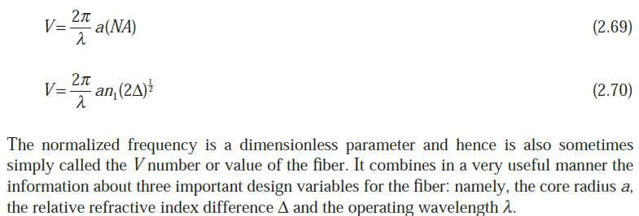
V-Number
The number of modes allowed in a given fiber are determined by a relationship between the wavelength of the light passing through the fiber, core diameter/radius of the fiber and material of the fiber. This relationship is known as V-number or normalized frequency parameter.
Mathematically, V- number is expressed as

Slide 87
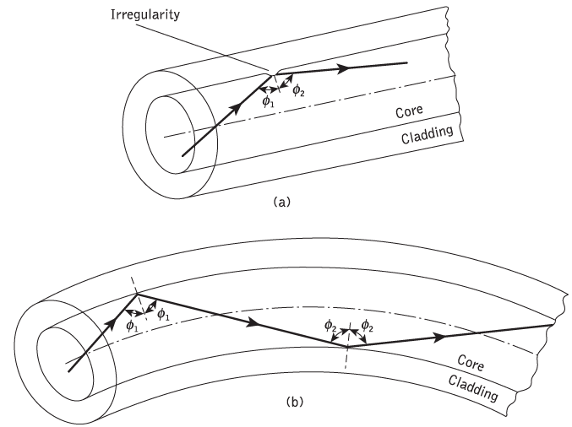
Mode coupling-1
We have thus far considered the propagation aspects of perfect dielectric waveguides.
However, waveguide perturbations such as deviations of the fiber axis from straightness, variations in the core diameter, irregularities at the core–cladding interface and refractive index variations may change the propagation characteristics of the fiber.
These will have the effect of coupling energy traveling in one mode to another depending on the specific perturbation.

Slide 88
Mode coupling-2
Ray theory aids the understanding of this phenomenon, as shown in Figure 2.20, which illustrates two types of perturbation.
It may be observed that in both cases the ray no longer maintains the same angle with the axis.
In electromagnetic wave theory this corresponds to a change in the propagating mode for the light.
Thus individual modes do not normally propagate throughout the length of the fiber without large energy transfers to adjacent modes, even when the fiber is exceptionally good quality and is not strained or bent by its surroundings.
This mode conversion is known as mode coupling or mixing.
It is usually analyzed using coupled mode equations which can be obtained directly from Maxwell’s equations.
Mode coupling affects the transmission properties of fibers in several important ways, a major one being in relation to the dispersive properties of fibers over long distances.

Slide 89
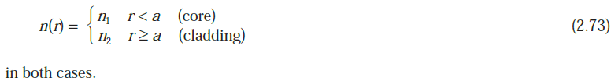
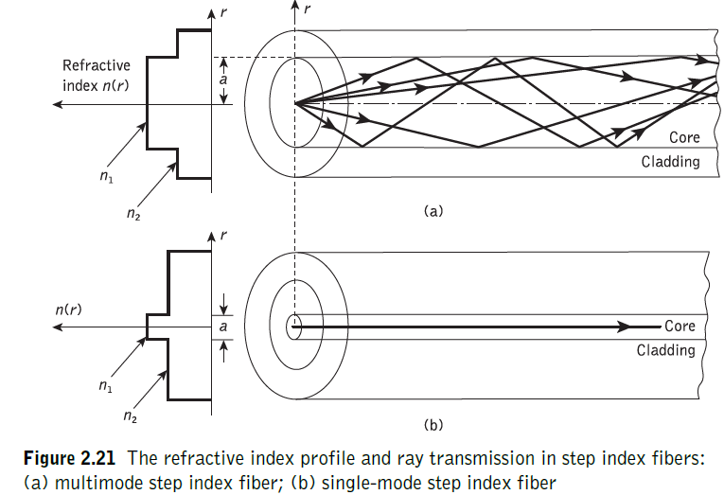
Step index fibers-1
The optical fiber considered in the preceding sections with a core of constant refractive index n1 and a cladding of a slightly lower refractive index n2 is known as step index fiber.
This is because the refractive index profile for this type of fiber makes a step change at the core–cladding interface, as indicated in Figure 2.21, which illustrates the two major types of step index fiber.
The refractive index profile may be defined as:

Slide 90
Step index fibers-2
Figure 2.21(a) shows a multimode step index fiber with a core diameter of around 50 μm or greater, which is large enough to allow the propagation of many modes within the fiber core.
This is illustrated in Figure 2.21(a) by the many different possible ray paths through the fiber.
Figure 2.21(b) shows a single-mode or monomode step index fiber which allows the propagation of only one transverse electromagnetic mode (typically HE11), and hence the core diameter must be of the order of 2 to 10 μm.
The propagation of a single mode is illustrated in Figure 2.21(b) as corresponding to a single ray path only (usually shown as the axial ray) through the fiber.
The single-mode step index fiber has the distinct advantage of low intermodal dispersion (broadening of transmitted light pulses), as only one mode is transmitted, whereas with multimode step index fiber considerable dispersion may occur due to the differing group velocities of the propagating modes.

Slide 91
Step index fibers-3
This in turn restricts the maximum bandwidth attainable with multimode step index fibers, especially when compared with single-mode fibers.
However, for lower bandwidth applications multimode fibers have several advantages over single-mode fibers.
These are:
(a) the use of spatially incoherent optical sources (e.g. most light-emitting diodes) which cannot be efficiently coupled to single-mode fibers;
(b) larger numerical apertures(NA), as well as core diameters(d), facilitating easier coupling to optical sources;
(c) lower tolerance requirements on fiber connectors.
Multimode step index fibers allow the propagation of a finite number of guided modes along the channel.

Slide 92
Step index fibers-4
The number of guided modes is dependent upon the physical parameters (i.e. relative refractive index difference, core radius) of the fiber and the wavelengths of the transmitted light which are included in the normalized frequency V for the fiber.
[It was indicated that there is a cutoff value of normalized frequency Vc for guided modes below which they cannot exist.
However, mode propagation does not entirely cease below cutoff.
Modes may propagate as unguided or leaky modes which can travel considerable distances along the fiber.
Nevertheless, it is the guided modes which are of paramount importance in optical fiber communications as these are confined to the fiber over its full length. ]

Slide 93
Step index fibers-5
It can be shown that the total number of guided modes or mode volume Ms for a step index fiber is related to the V value for the fiber by the approximate expression:
which allows an estimate of the number of guided modes propagating in a particular multimode step index fiber.

Slide 94
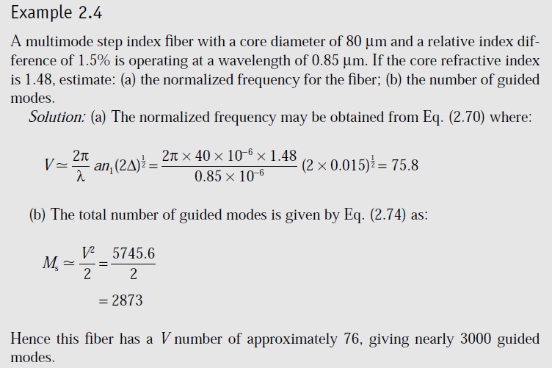

Slide 95
Step index fibers-6
Therefore, as illustrated in Example 2.4, the optical power is launched into a large number of guided modes, each having different spatial field distributions, propagation constants, etc.
In an ideal multimode step index fiber with properties (i.e. relative index difference, core diameter) which are independent of distance, there is no mode coupling, and the optical power launched into a particular mode remains in that mode and travels independently of the power launched into the other guided modes.
Also, the majority of these guided modes operate far from cutoff, and are well confined to the fiber core.
Thus most of the optical power is carried in the core region and not in the cladding.
The properties of the cladding (e.g. thickness) do not therefore significantly affect the propagation of these modes.

Slide 96
Graded index fibers-1
Graded index fibers do not have a constant refractive index in the core but a decreasing core index n(r) with radial distance from a maximum value of n1 at the axis to a constant value n2 beyond the core radius a in the cladding.
This index variation may be represented as:
where Δ is the relative refractive index difference and α is the profile parameter which gives the characteristic refractive index profile of the fiber core.
Equation (2.75) which is a convenient method of expressing the refractive index profile of the fiber core as a variation of α, allows representation of the step index profile when α = ∞, a parabolic profile when α = 2 and a triangular profile when α = 1.
This range of refractive index profiles is illustrated in Figure 2.22.

Slide 97
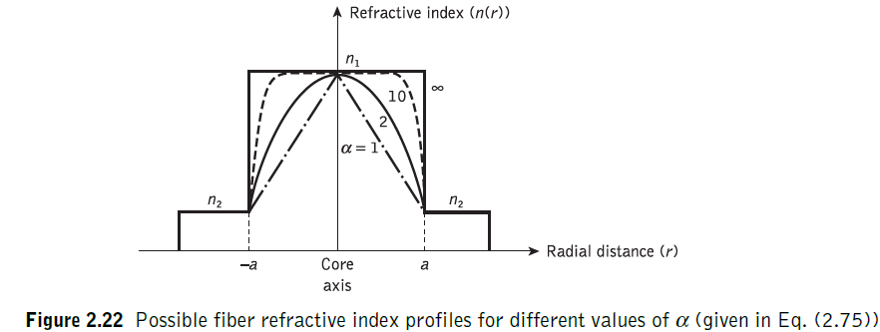
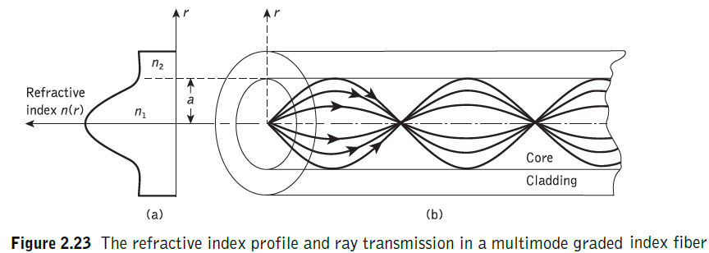
Graded index fibers-2

Slide 98
Graded index fibers-3
The graded index profiles which at present produce the best results for multimode optical propagation have a near parabolic refractive index profile core with α ≈ 2.
Fibers with such core index profiles are well established and consequently when the term ‘graded index’ is used without qualification it usually refers to a fiber with this profile.
For this reason in this section we consider the waveguiding properties of graded index fiber with a parabolic refractive index profile core.
A multimode graded index fiber with a parabolic index profile core is illustrated in Figure 2.23.
It may be observed that the meridional rays shown appear to follow curved paths through the fiber core.

Slide 99
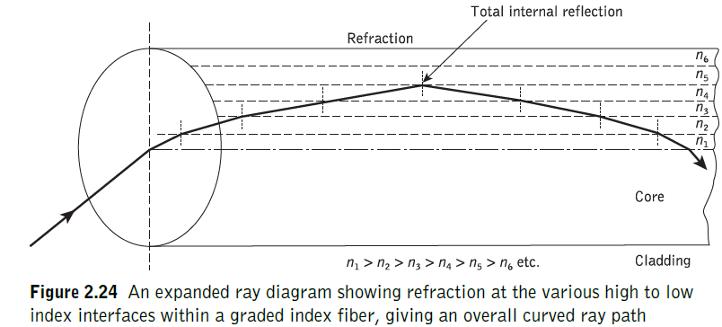
Graded index fibers-4
Using the concepts of geometric optics, the gradual decrease in refractive index from the center of the core creates many refractions of the rays as they are effectively incident on a large number or high to low index interfaces.
This mechanism is illustrated in Figure 2.24 where a ray is shown to be gradually curved, with an ever increasing angle of incidence, until the conditions for total internal reflection are met, and the ray travels back towards the core axis, again being continuously refracted.

Slide 100
Graded index fibers-5
Multimode graded index fibers exhibit far less intermodal dispersion than multimode step index fibers due to their refractive index profile.
Although many different modes are excited in the graded index fiber, the different group velocities of the modes tend to be normalized by the index grading.
Again considering ray theory, the rays traveling close to the fiber axis have shorter paths when compared with rays which travel into the outer regions of the core.
However, the near axial rays are transmitted through a region of higher refractive index and therefore travel with a lower velocity than the more extreme rays.
This compensates for the shorter path lengths and reduces dispersion in the fiber.

Slide 101
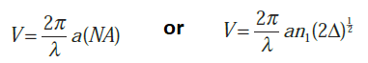
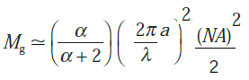
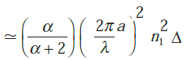
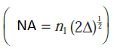
Graded index fibers-6
The number of modes supported by graded index fiber is given by
We know that V-number or Normalized frequency is given as
The maximum number of modes supported by a graded index fiber is
or
Hence for a parabolic refractive index profile core fiber (α = 2), , which is half the number supported by a step index fiber (α = ∞) with the same V value.

Slide 102
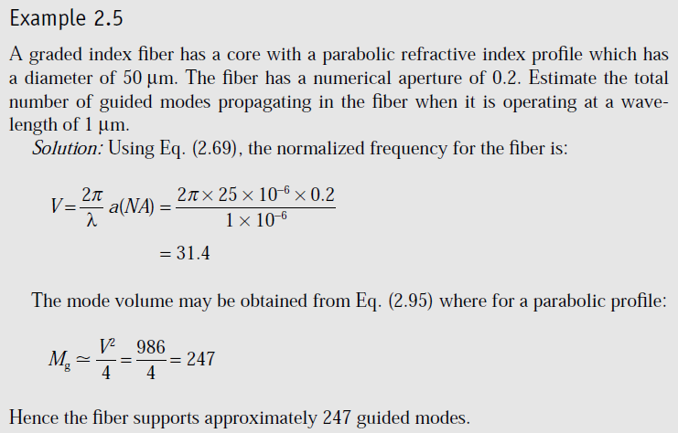

Slide 103
Single-mode fibers-1
The advantage of the propagation of a single mode within an optical fiber is that the signal dispersion caused by the delay differences between different modes in a multimode fiber may be avoided.
Multimode step index fibers do not lend themselves to the propagation of a single mode due to the difficulties of maintaining single-mode operation within the fiber when mode conversion (i.e. coupling) to other guided modes takes place at both input mismatches and fiber imperfections.
Hence, for the transmission of a single mode the fiber must be designed to allow propagation of only one mode, while all other modes are attenuated by leakage or absorption.

Slide 104
Single-mode fibers-2
For single-mode operation, only the fundamental LP01 mode can exist.
Hence the limit of single-mode operation depends on the lower limit of guided propagation for the LP11 mode.
The cutoff normalized frequency for the LP11 mode in step index fibers occurs at Vc = 2.405.
Thus single-mode propagation of the LP01 mode in step index fibers is possible over the range:
0 ≤ V < 2.405 …..(2.96)
as there is no cutoff for the fundamental mode. It must be noted that there are in fact two modes with orthogonal polarization over this range, and the term single-mode applies to propagation of light of a particular polarization.
Also, it is apparent that the normalized frequency for the fiber may be adjusted to within the range given in Eq. (2.96) by reduction of the core radius, and possibly the relative refractive index difference following Eq. (2.70),which, for single-mode fibers, is usually less than 1%.

Slide 105
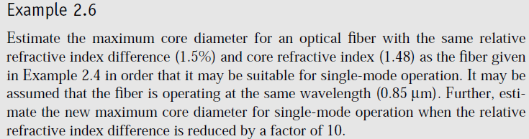
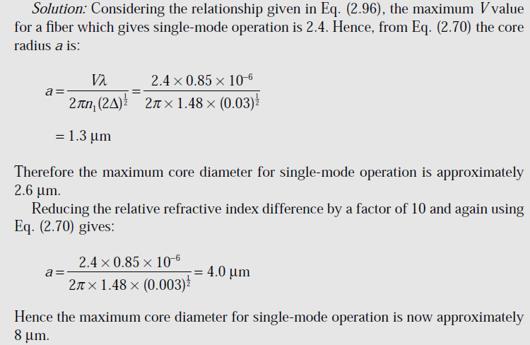

Slide 106
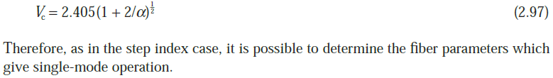
Single-mode fibers-3
It is clear from Example 2.6 that in order to obtain single-mode operation with a maximum V number of 2.4, the single-mode fiber must have a much smaller core diameter than the equivalent multimode step index fiber (in this case by a factor of 32).
However, it is possible to achieve single-mode operation with a slightly larger core diameter, albeit still much less than the diameter of multimode step index fiber, by reducing the relative refractive index difference of the fiber.
Both these factors create difficulties with single-mode fibers.
The small core diameters pose problems with launching light into the fiber and with field jointing, and the reduced relative refractive index difference presents difficulties in the fiber fabrication process.
Graded index fibers may also be designed for single-mode operation and some specialist fiber designs do adopt such non step index profiles.
However, it may be shown that the cutoff value of normalized frequency Vc to support a single mode in a graded index fiber is given by:

Slide 107
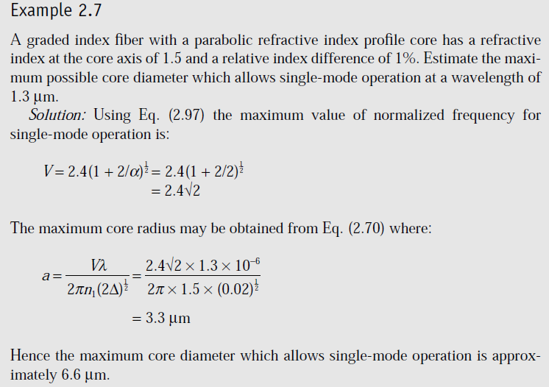

Slide 108
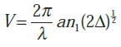
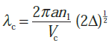
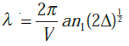


Cutoff wavelength-1
It may be noted by rearrangement of Eq. that single-mode operation only occurs above a theoretical cutoff wavelength λc given by:
Where Vc is the cutoff normalized frequency.
Hence λc is the wavelength above which a particular fiber becomes single-moded.
Dividing Eq. by Eq. for the same fiber we obtain the inverse relationship:
Thus for step index fiber where Vc = 2.405, the cutoff wavelength is given by

Slide 109
Cutoff wavelength-2
An effective cutoff wavelength has been defined by the ITU-T, which is obtained from a 2 m length of fiber containing a single 14 cm radius loop.
This definition was produced because the first higher order LP11 mode is strongly affected by fiber length and curvature near cutoff.
Recommended cutoff wavelength values for primary coated fiber range from 1.1 to 1.28 μm for single-mode fiber designed for operation in the 1.3 μm wavelength region in order to avoid modal noise and dispersion problems.
Moreover, practical transmission systems are generally operated close to the effective cutoff wavelength in order to enhance the fundamental mode confinement, but sufficiently distant from cutoff so that no power is transmitted in the second-order LP11 mode.

Slide 110


Slide 111
Mode-field diameter and spot size-1
Many properties of the fundamental mode are determined by the radial extent of its electromagnetic field including losses at launching and jointing, microbend losses, waveguide dispersion and the width of the radiation pattern.
Therefore, the MFD is an important parameter for characterizing single-mode fiber properties which takes into account the wavelength-dependent field penetration into the fiber cladding.
In this context it is a better measure of the functional properties of single-mode fiber than the core diameter.
For step index and graded (near parabolic profile) single-mode fibers operating near the cutoff wavelength λc, the field is well approximated by a Gaussian distribution.
In this case the MFD is generally taken as the distance between the opposite 1/e = 0.37 field amplitude points and the power 1/e2 = 0.135 points in relation to the corresponding values on the fiber axis, as shown in Figure 2.31.

Slide 112

Mode-field diameter and spot size-2

Slide 113
Mode-field diameter and spot size-3
Another parameter which is directly related to the MFD of a single-mode fiber is the spot size (or mode-field radius) ω0.
Hence MFD = 2ω0, where ω0 is the nominal half width of the input excitation (see Figure 2.31).
The MFD can therefore be regarded as the single mode analog of the fiber core diameter in multimode fibers.
However, for many refractive index profiles and at typical operating wavelengths the MFD is slightly larger than the single-mode fiber core diameter.
Often, for real fibers and those with arbitrary refractive index profiles, the radial field distribution is not strictly Gaussian and hence alternative techniques have been proposed.

Slide 114
Mode-field diameter and spot size-4
However, the problem of defining the MFD and spot size for non-Gaussian field distributions is a difficult one and at least eight definitions exist.
Nevertheless, a more general definition based on the second moment of the far field and known as the Petermann II definition is recommended by the ITU-T.
Moreover, good agreement has been obtained using this definition for the MFD using different measurement techniques on arbitrary index fibers.

Slide 115



Effective refractive index-1
The rate of change of phase of the fundamental LP01 mode propagating along a straight fiber is determined by the phase propagation constant β.
It is directly related to the wavelength of the LP01 mode λ01 by the factor 2π, since β gives the increase in phase angle per unit length.
Hence:
Moreover, it is convenient to define an effective refractive index for single-mode fiber, sometimes referred to as a phase index or normalized phase change coefficient neff, by the ratio of the propagation constant of the fundamental mode to that of the vacuum propagation constant:
Hence, the wavelength of the fundamental mode λ01 is smaller than the vacuum wavelength λ by the factor 1/neff where:

Slide 116
Effective refractive index-2
[It should be noted that the fundamental mode propagates in a medium with a refractive index n(r) which is dependent on the distance r from the fiber axis.
The effective refractive index can therefore be considered as an average over the refractive index of this medium.
Within a normally clad fiber, not depressed-cladded fibers, at long wavelengths (i.e. small V values) the MFD is large compared to the core diameter and hence the electric field extends far into the cladding region.
In this case the propagation constant β will be approximately equal to n2k (i.e. the cladding wave number) and the effective index will be similar to the refractive index of the cladding n2. ]
Physically, most of the power is transmitted in the cladding material.

Slide 117
Effective refractive index-3
At short wavelengths, however, the field is concentrated in the core region and the propagation constant β approximates to the maximum wave number n1k.
Following this discussion, and as indicated previously in Eq. (2.62), then the propagation constant in single-mode fiber varies over the interval n2k < β < n1k.
Hence, the effective refractive index will vary over the range n2 < neff < n1.
In addition, a relationship between the effective refractive index and the normalized propagation constant b defined in Eq. (2.71) as:

Slide 118

Effective refractive index-4

Slide 119

Effective refractive index-5
The dimensionless parameter b which varies between 0 and 1 is particularly useful in the theory of single-mode fibers because the relative refractive index difference is very small, giving only a small range for β.
Moreover, it allows a simple graphical representation of results to be presented as illustrated by the characteristic shown in Figure 2.32 of the normalized phase constant of b as a function of normalized frequency V in a step index fiber.
It should also be noted that b(V) is a universal function which does not depend explicitly on other fiber parameters.

Slide 120

`

Slide 122


Slide 123


Slide 124


Slide 125


Slide 126


Slide 127


Slide 128


Slide 129


Slide 130


Slide 131


Slide 132


Slide 133


Slide 134


Slide 135


Slide 136


Slide 137


Slide 138


Slide 139


Slide 140


Slide 141


Slide 142


Slide 143


Slide 144


Slide 145


Slide 146


Slide 147


Slide 148


Slide 149


Slide 150


Slide 151


Slide 152


Slide 153


Slide 154


Slide 155


Slide 156


Slide 157


Slide 158


Slide 159


Slide 160


Slide 161


Slide 162


Slide 163


Slide 164


Slide 165


Slide 166


Slide 167


Slide 168


Slide 169


Slide 170


Slide 171


Slide 172


Slide 173


Slide 174


